Slide 1
LECTURE 1
Course Overview, Introduction to Python

Slide 2
Agenda
Introductions
Logistics
What is Data Science
Python
Expression & Values
Functions

Slide 3


Teachers
Danny Wu
Tina Lin
Notes:
Name, year, school, why are we teaching, plans for the future, and our hobbies

Slide 4

Teacher Assistant
Saisri Padmanabhuni

Slide 5
Zoom Rules
Type your questions into the chat or raise your hand on Zoom
Turn your camera on if you are able to
Do not share the Zoom password with anyone not in the class
Have the name or preferred name in parentheses and your pronouns as your display name
Please stay muted unless you are asking a question
Participate through “Reactions” or in chat

Slide 6
Course Policies
Attendance is MANDATORY
Certificate of Completion
Optional (can be added to college applications and resumes)
5/6 lecture attended
Participation (up to our discretion)
Labs completed and correct
Submission of final project
Email Communication
Send to both teachers
Subject line format: [cip] Intro to Data Science | *subject of email*
Notes:
One unexcused absence without prior notification

Slide 7
Course Information
Recommended: Algebra 2
Google classroom
2vimpi3
Office Hours
Monday, Thursday 7:15 - 8:00 PM, PST
Goals
Dip your toes into the wonderful world of data science
Practice
Lab after each lecture
Final Project (More info later)
Notes:
All this can also be found on the syllabus
Google classroom (pm Danny in chat):
Everything will be posted here (lecture slides after & recordings)
Introduction post
Way to communication
Help on assignments here and talk to classmates
Can ask for clarification or help on bug but DO NOT SEND ANSWER OR CODE
Have it be the name you used when signing up
Office hours
Same zoom link
Great way to get help on assignments, ask questions not answered in lecture, or to go beyond the material
Assignments
Learn best through practice
Google Calendar

Slide 8
What is Data Science?
“Data science is the application of data centric, computational, and inference thinking to understand the world and solve problems
Joey Gonzalez (co-creator of Data100 @ UC Berkeley)
Notes:
Ask for interpretation

Slide 9
Python
Notes:
Used in data science as well as r
Easy syntax to pick up because very similar to english

Slide 10
Expressions & Values
Program manipulate values
Expressions evaluate to values
Expression: ‘he’ + ‘llo’
Value: ‘hello’
Python interpreter evaluates the expressions and displays the value

Slide 11
Values
Each value has a certain data type
Data type
Example values
Integers
2 18 -9
Floats
3.14 60.2 -5.0
Booleans
True False
Strings
‘two’ ‘data science’

Slide 12
Discussion
64.1
111
2.0
‘type’
‘2.3’

Slide 13
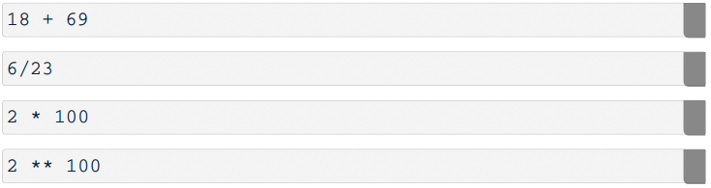
Expressions
An expression describes a computation and evaluates to a value
Some expressions use operators:

Slide 14
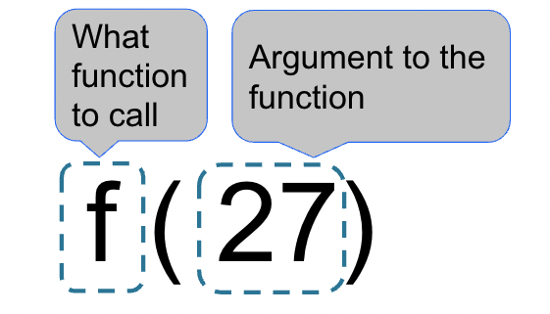
Call Expressions
Notes:
Expressions that use function calls

Slide 15
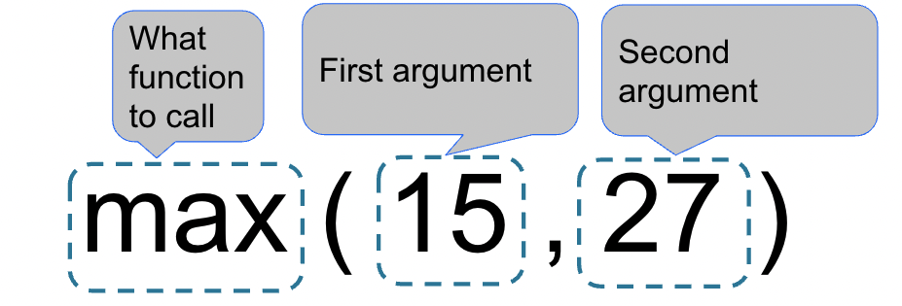
Call Expressions
(Demo)
Notes:
Expressions that use function calls

Slide 16
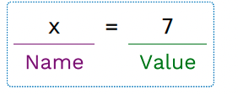
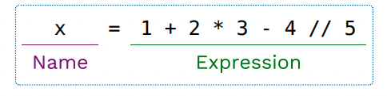
Names
A name can be bound to a value
One way to bind a name is with an assignment statement
The value can be any expression
(Demo)

Slide 17
Functions

Slide 18
Functions
Function is a sequence of code that performs a particular task and can be easily reused
A function takes inputs (arguments) and returns an output (return value)

Slide 19
Defining Functions
Use a def statement to define a function
The first line is the function signature and the second line is the function body
(Demo)

Slide 20
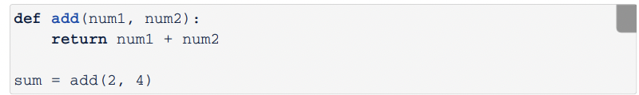
Return Values
The return value returns a value from the function called and exits the function
You can use function calls in expressions
(Demo)

Slide 21
None Value
A None value represent nothingness in Python
Any function that doesn’t explicitly return a value returns None
(Demo)

Slide 22
Print
Built in Python function that prints a value on the console log
The data type of print values are none
(Demo)

Slide 23
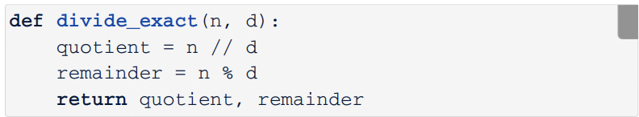
More Function Features

